Slide 1
Nakuja Internship 2026
Solid Propulsion Team
Weekly report #11
Presented by: Ben Wetu
August 28, 2026

Slide 2
This week's tasks
Cooking of grains
Liner preparation
Nozzle and bulkhead fabrication
5 grain static test

Slide 3
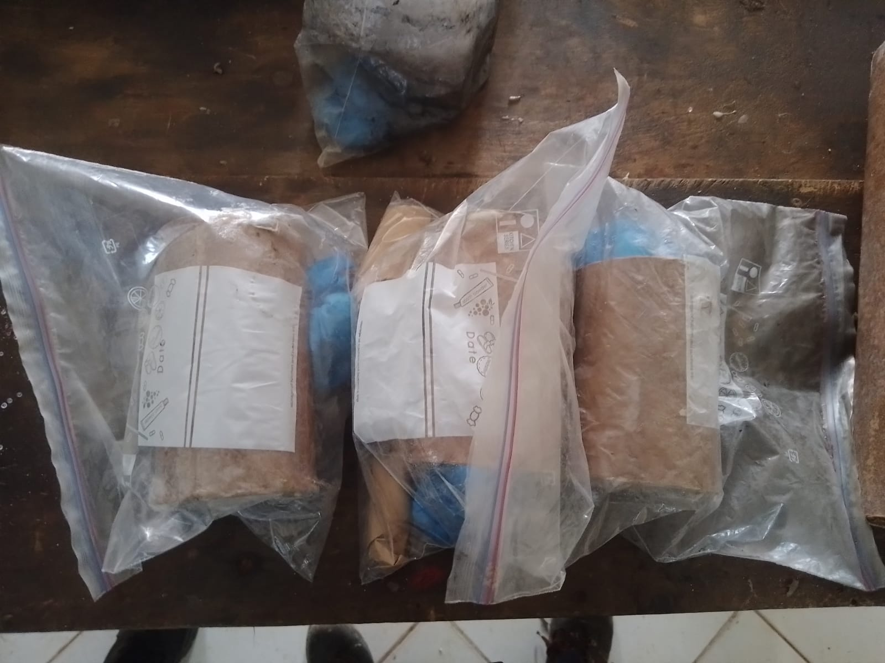
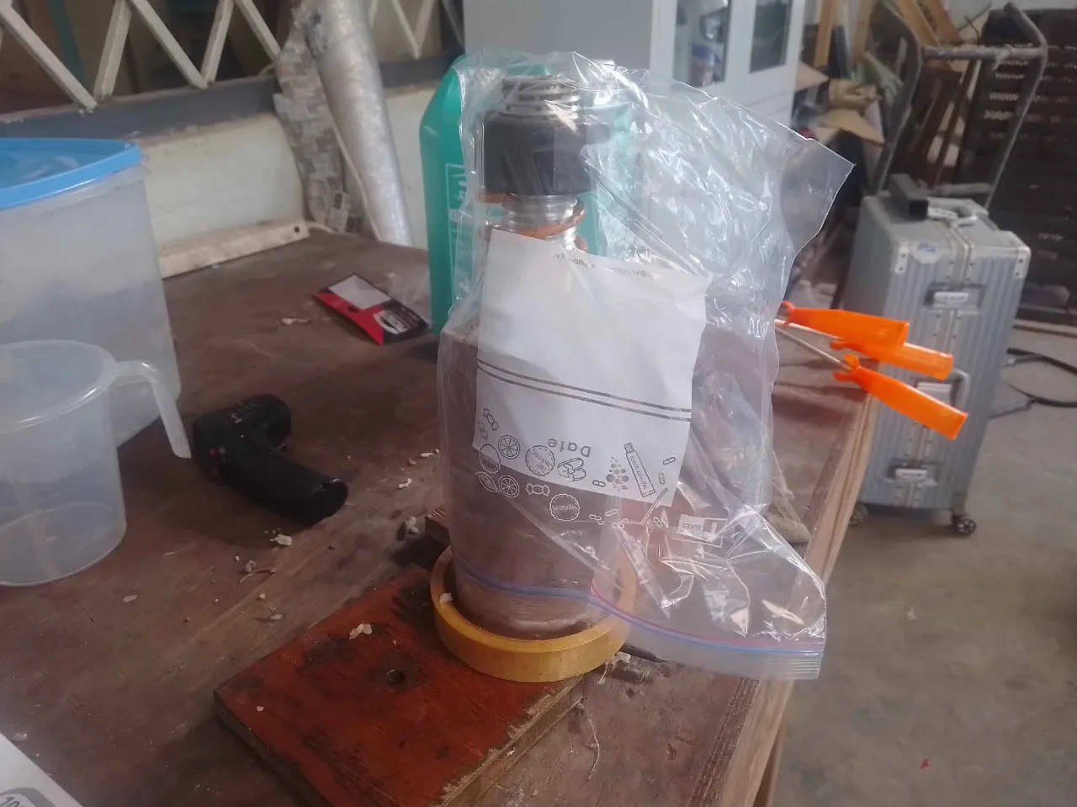
Cooking of grains for 5 & 4 grain test
Purpose: These grains will be used during the 5 grain static test was held on Wednesday 26/08/2026 and 4 grain on Friday 4/09/2026.
Result: 6 out of 9 grains have been prepared

Slide 4
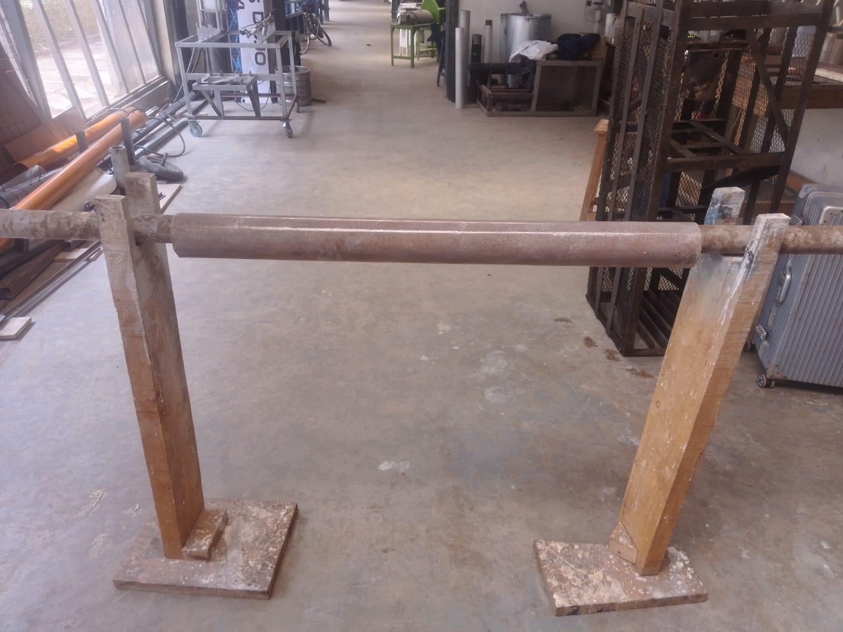
2. Liner preparation
Purpose: In preparation of the static tests campaign, we have fabricated 2 liners and both can fit the Aluminium and Stainless Steel dimensions.
Result: 6 out of 7 liners have been fabricated

Slide 5
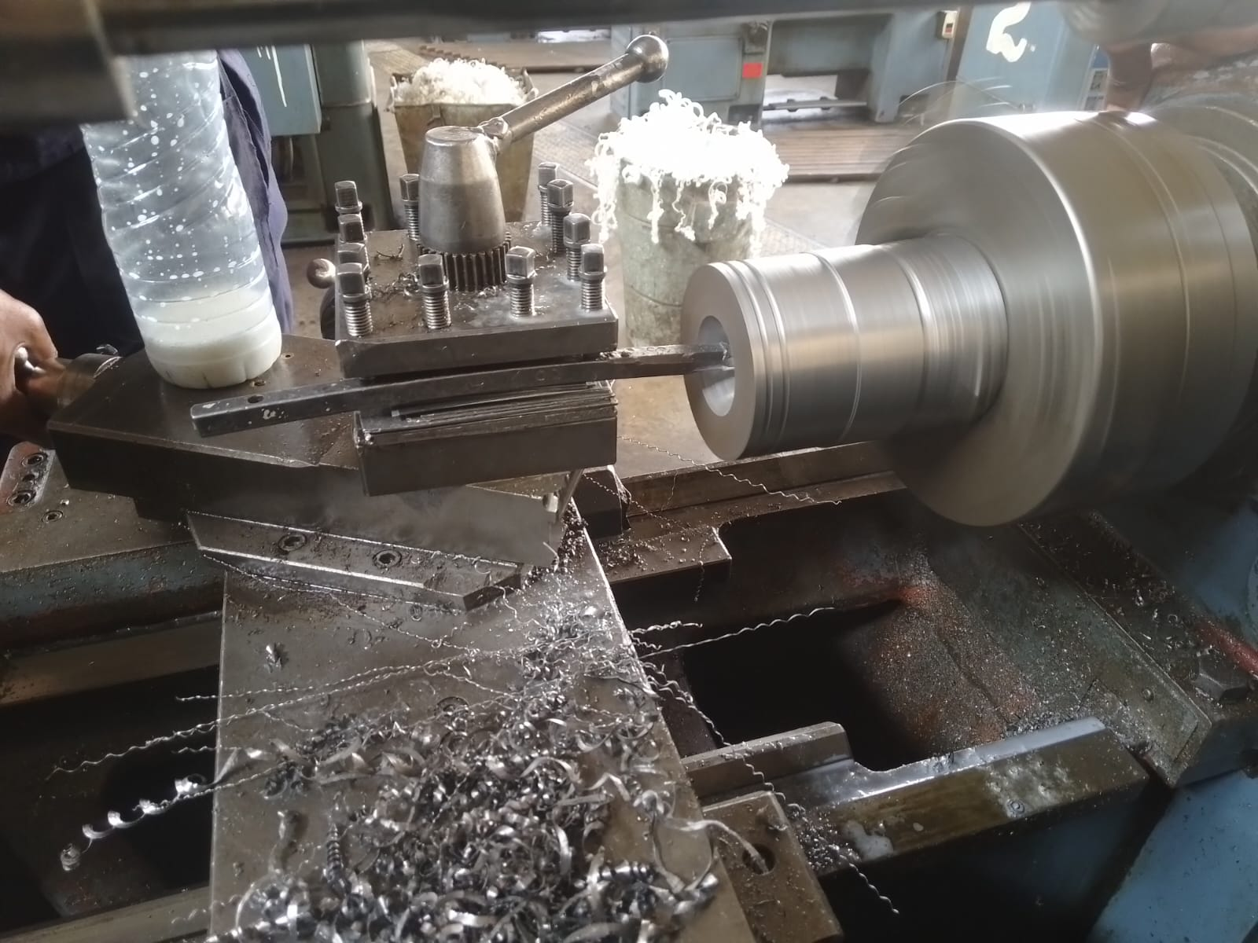
3. Machining of nozzle and bulkhead
Purpose: In preparation of the 4 grain static test, nozzle and bulkhead machining has began.
Result:

Slide 6
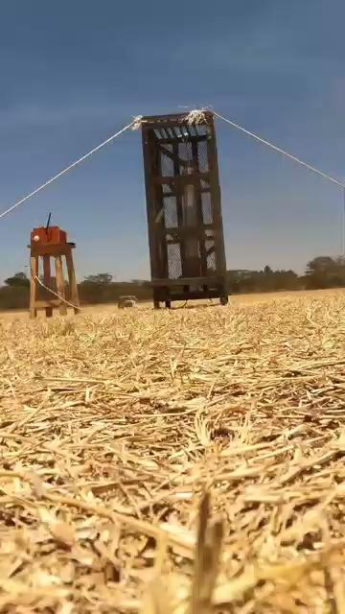
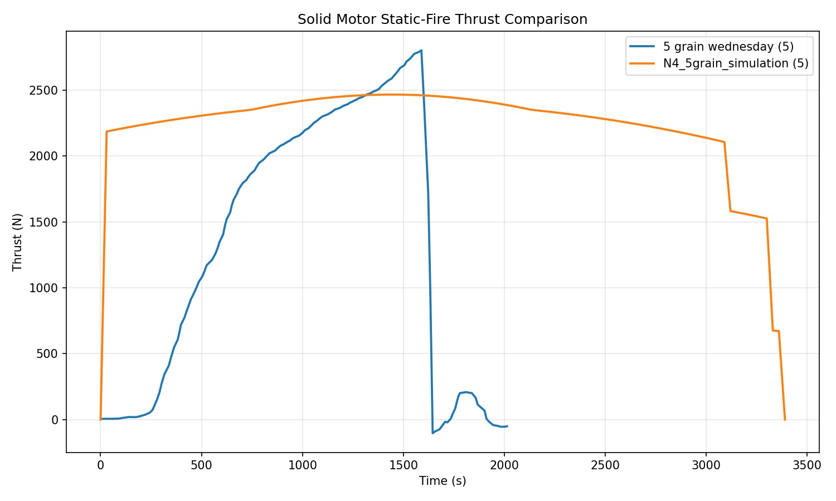
4. 5 grain static test
Purpose: This test was done in preparation for launch of the N4 rocket. 1.4g of Sodium Bicarbonate was added to each grain in an attempt to suppress the burn rate.
Result: The static test experienced CATO (Catastrophe At Take Off) as there was a rapid increase in pressure which caused the Solid Rocket Motor to explode.

Slide 7
Probable causes + solutions
Back burn -this was caused by movement of heat outside the thermal liner. This was because the liner had space between the casing.
Solution -use two liners for extra insulation. One continuous across the casing, another for individual grains.
Weak Aluminium alloy used -the Al 6063-T5 alloy used had a safety factor of 1.5 which decreases with increase in temperature.
Proposed changes:
Add 14g of Sodium Bicarbonate to the 5 grain test
Add 2.8g of Sodium Bicarbonate to 4 grain test

Slide 8
Next week’s tasks
Motor assembly for 4 grain test
4 grain static test using Stainless Steel dimensions
5 grain static test with added suppressant
Compile report

Slide 9
Challenges experienced
None experienced
Supervisors’ note:
Visit Solid Propulsion github projects @ https://github.com/orgs/nakujaproject/projects/26 to review the tasks done.

Slide 10
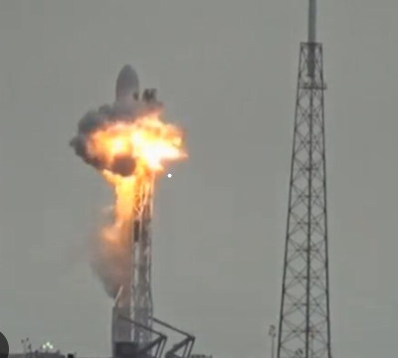
Thank you for your attention!

